Slide 1
CS 4530
Fundamentals of Software Engineering
Module 16: Refactoring and Technical Debt
Adeel Bhutta, Jan Vitek, Mitch Wand
Khoury College of Computer Sciences
© 2023 Released under the CC BY-SA license

Slide 2
Learning Goals
By the end of this lesson, you should be able to…
Define refactoring, technical debt, and give examples.
Explain how refactoring fits into agile process and help reduce technical debt
Suggest when it may be appropriate to accrue technical debt and when it may be appropriate to retire it

Slide 3
Refactoring
Refactoring is the process of applying transformations, refactorings, to a program
Goals:
keep program readable, understandable, and maintainable
by eliminating small problems soon, you can avoid big troubles later
Characteristics:
behavior-preserving, i.e. do not change what the program does
incremental, i.e. proceeds in small steps with tests at each stage
Notes:
The process of changing the source code of a software system such that:
The external (observable) behavior of the system does not change - e.g., functional requirements are maintained
But the internal structure of the system is improved

Slide 4
Example
Original Code
function greeter (firstName : String, lastName : String) { return "Hello, " + firstName + " " + lastName;
}
document.body.innerHTML = greeter(“Jane","Doe");
Refactored Code # 1
function greeter (firstName : String, lastName : String, greeting = "Hello, ") {
return greeting + firstName + " " + lastName;
}
document.body.innerHTML = greeter(“Jane”,"Doe");
Refactored Code # 2
function greeter (firstName : String, lastName : String, greeting : String) {
return greeting + firstName + " " + lastName;
}
document.body.innerHTML = greeter(“Jane","Doe“,"Hello, ");
Notes:
Here is a simple example: removing a hardcoded string as introducing it as parameter. This is an optional parameter in first version of refactoring. In the next version, we could make that a required parameter
More examples at
https://www.jetbrains.com/help/webstorm/specific-typescript-refactorings.html#typescript_extract_parameter

Slide 5
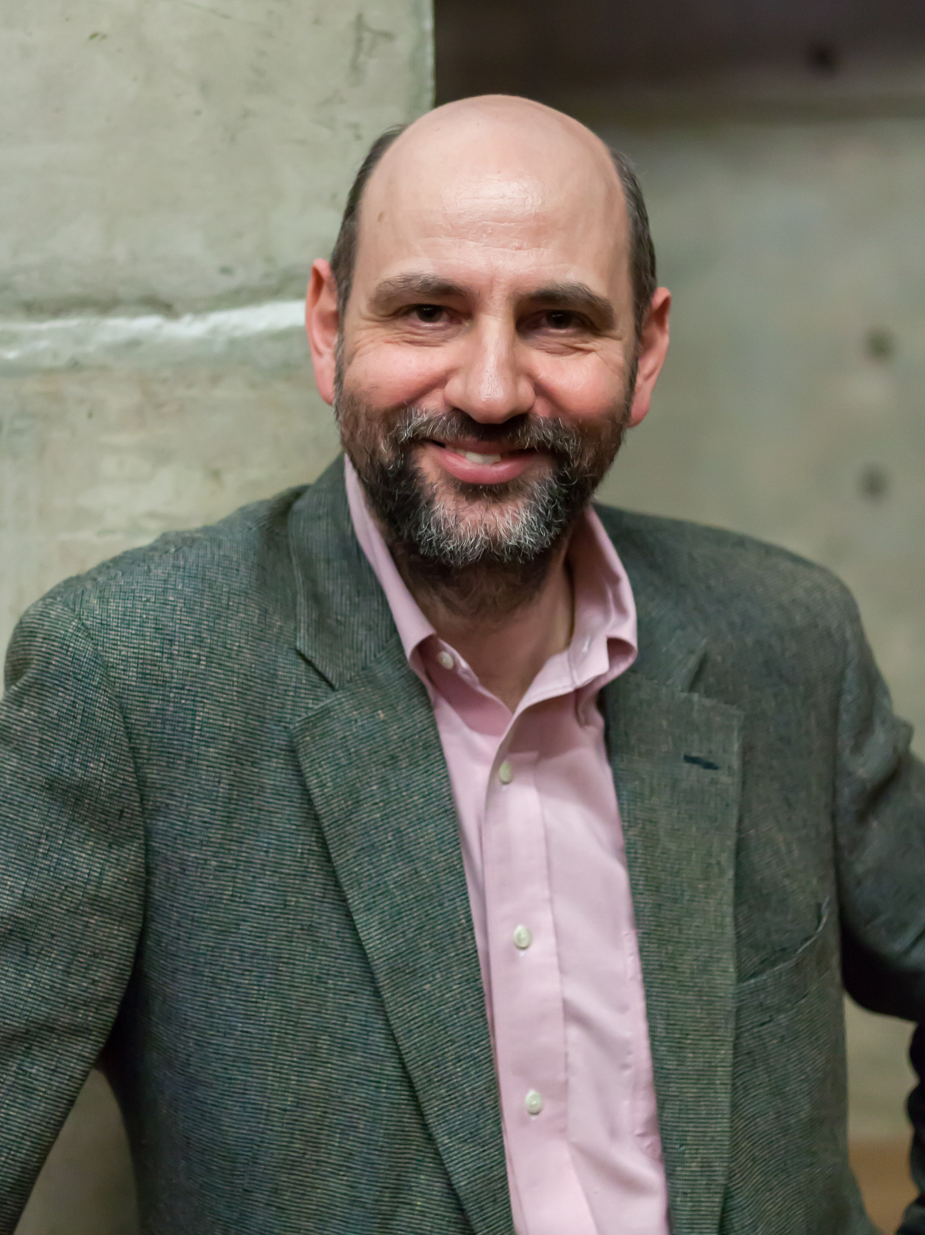
Dad
Martin Fowler is the “father” of refactoring
“Any fool can write code that a computer can understand
Good programmers write code that humans can understand”
Notes:
Martin Fowler is the author of many works on software engineering methodology, including the original text on refactoring. Not inventor of refactoring by any means, but an evangelist for refactoring and related development methodologies

Slide 6

The Book
A catalogue of refactorings, similar to the design patterns in the GoF book
Names each transformation
Helpful for team communication
Names “bad smells” (triggers for refactorings)
Discusses when and how to apply refactorings
Many refactorings are the inverse of another refactoring
often there is not a unique “best” solution
discussion of the tradeoffs
Notes:
also in the book:
UML diagrams to illustrate the situation before and after
examples of code before and after each refactoring

Slide 7
The List
Fowler gave colorful names his “code smells”
Loops
Lazy Element
Speculative Generality
Temporary Field
Message Chains
Middle Man
Insider Trading
Large Class
Alternative Classes with Different Interfaces
Data Class
Refused Bequest
Mysterious Name
Duplicated Code
Long Function
Long Parameter List
Global Data
Mutable Data
Divergent Change
Shotgun Surgery
Feature Envy
Data Clumps
Primitive Obsession
Repeated Switches
Notes:
‘Code’ smells is a fancy name for small mistakes or code patterns that are good candidates for refactoring. Here is a list of Fowler’s named code smells. The powerpoint contains live links to the definitions in the book.

Slide 8
Renaming
Is the most common…
Rename Function (124) (to rename a function)
Rename Variable (137)
Rename Field (244).
We are often afraid to rename things, thinking it’s not worth the trouble, but a good name can save hours of future puzzled incomprehension
Renaming is not just an exercise
When you are not happy with a name, it’s often a sign of a deeper design malaise.
Puzzling over a tricky name leads to significant improvements to your code
Notes:
It is widely believed that naming is one of the two hardest things in programming. So, perhaps the most common refactorings we do are the renameings: Change Function Declaration (124) (to rename a function), Rename Variable (137), and Rename Field (244). People are often afraid to rename things, thinking it’s not worth the trouble, but a good name can save hours of puzzled incomprehension in the future.
Renaming is not just an exercise in changing names. When you can’t think of a good name for something, it’s often a sign of a deeper design malaise. (For example, names like MartianCounterHelper– what does that mean?) Puzzling over a tricky name often leads to significant improvements to your code.

Slide 9


Renaming
Luckily, VSC automates this and many other common transformations
Notes:
Many IDEs will automate this and other common transformations.

Slide 10
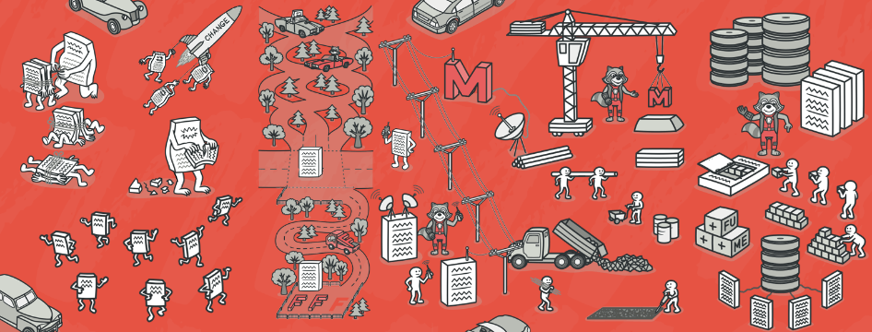
Local Refactorings
https://refactoring.guru/
Rename | provides better intuition for renamed thing’s purpose
Extract Method | enables reuse; avoids cut-and-paste; improves readability
Inline Method | replace a method call with method’s body; often intermediate step
Extract Local | introduce a new local variable for an expression
Inline Local | replace a local variable with the expression that defines its value
Change Method Signature | reorder a method’s parameters
Encapsulate Field | introduce getter/setter methods
Convert Local Variable to Field | sometimes useful to enable application of Extract Method
Notes:
some examples of widely used refactorings that are “local” in scope
useful for restructuring methods
We already talked about bad names and duplicate code. We would fix these smells by applying refactoring rename and extract method, resp
Inline method is inverse: when you want to go fold a method back into another
Extract local variable is like extract method, but what you might do with just an expression, so that a big expression can be more manageable
Again, inline local is the inverse: eliminating a local variable that is maybe superfluous
Change function declaration lets us adapt the order of parameters on a method
encapsulate a field replaces direct field accesses with getters/setters, and
Convert local to field creates a field with the specified scope to replace a local variable.
These are just a few of the hundreds of refactorings in Fowler’s book

Slide 11
Type-Related Refactorings
aka Refactoring by Abstraction
Bad abstraction is worst than duplication
(pieces of code that look the same, still represent different concepts).
Use “Rule of Three” – Three strikes and you refactor
Generalize Declared Type | replace type of a declaration with more general type
Extract Interface | create new interface, and update code to use it where possible
Pull Up Members | move methods and fields to a superclass
Infer Generic Type Arguments | infer type arguments for “raw” uses of generic types
https://understandlegacycode.com/blog/refactoring-rule-of-three/
Notes:
refactorings for changing the class hierarchy and/or the types of declarations of variables and fields. This is also known as Refactor by Abstraction
purpose is to make designs more flexible, e.g., by facilitating the introduction of design patterns . Few points to mention, some duplication may be acceptable especially if the code looks the same but represents different concepts. Don’t have to refactor every duplicate line of code. One suggestion would be to use “Rule of 3”, if you see something three times, it should be refactored.
https://understandlegacycode.com/blog/refactoring-rule-of-three/
Way, way more refactoring than this. Again, over a hundred. What’s most useful is often what’s automated…

Slide 12
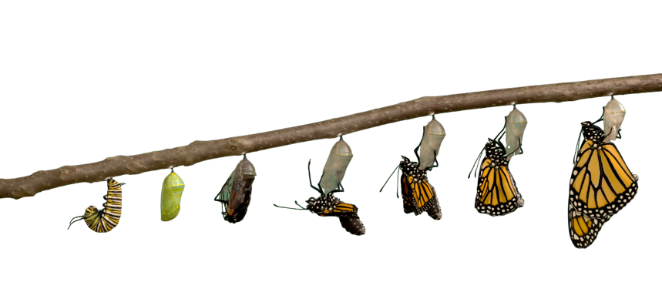
Why Refactor?
New or anticipated requirements require a different design
Altered design will make testing easier
Altered design will improve maintainability
Fix sloppiness by programmers
Retire or avoid technical debt
Notes:
We’ve talked about what refactorings are. But why would you want to refactor?

Slide 13
When to refactor?
Refactoring is incremental redesign
Acknowledge that it is difficult to get design right the first time
When?
adding new functionality,
fixing a bug,
doing code review, or
any time
A key part of TDD!
Refactoring evolves design in increments
Refactoring reduces technical debt
Notes:
When you add new functionality
Do it before you add the new function, to make it easier to add the function
Or do it after you add the function, to clean up the code including that function
When you need to fix a bug
As you do a code review
Whenever…
The idea behind refactoring is to acknowledge that it will be difficult to get a design right the first time
And as a program’s requirements change, the design may need to change
It is notoriously difficult (impossible?) to design for all possible changes a priori
And as agile programming proponents say, “You aren’t gonna need it” – but what if later you do?
Refactoring provides techniques for evolving the design in small incremental steps
Technical debt: The project’s requirements are constantly changing and at some point it may become obvious that parts of the code are obsolete, have become cumbersome, and must be redesigned to meet new requirements. On the other hand, the project’s programmers are writing new code every day that works with the obsolete parts. Therefore, the longer refactoring is delayed, the more dependent code will have to be reworked in the future.

Slide 14
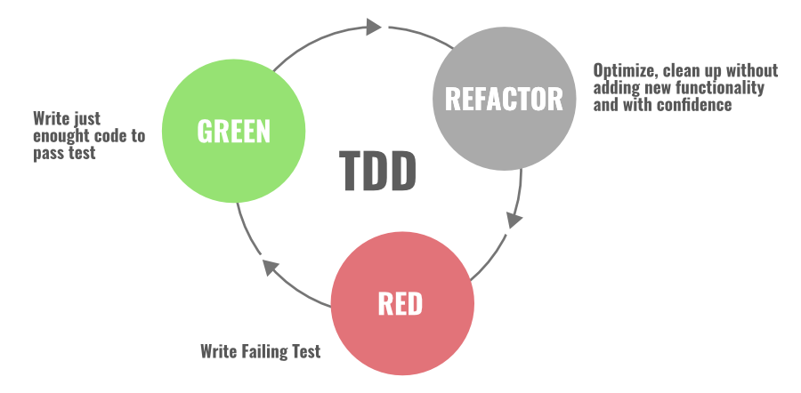
Refactoring with TDD
Red: start writing failing “red-test”. Stop and check what needs to be written
Green: next, write simplest code that gets tests to “green”
Refactor: finally, focus on improving & enhancing code while keeping test green
Notes:
Red-Green is the most popular and widely used code refactoring technique in the Agile software development process. This technique follows the “test-first” approach to design and implementation, this lays the foundation for all forms of refactoring.

Slide 15
Refactoring Benefits
Small incremental steps that preserve program behavior
…simplify regression testing
Aiming for simple steps
…allows for automation
Refactoring needs not proceed in a straight line
…sometimes, you want to undo a step you did earlier
…when you have insights for a better design
Having a name for what you did makes undos easier
Notes:
Refactoring is a series of small behavior-preserving transformations
Each transformation does little, but a sequence of transformations can produce a significant restructuring
Since each refactoring is small, it's less likely to go wrong
The system is also kept fully working after each small refactoring (via regression testing), reducing the chances that a system can get seriously broken during the restructuring

Slide 16
Refactoring Risks
Developer time is valuable: is this the best use of time today?
Despite best intentions, may not be safe
Potential for version control conflicts
Notes:
If programmers spend time “cleaning up the code”, then that’s less time spent implementing required functionality - and the schedule is slipping as it is!
Refactoring can break code that previously worked

Slide 17

Technical Debt
… is the accumulation of internal problems in a code base
Internal because they don’t show as user-visible failures
Examples:
Code Smells
Missing tests
Missing documentation
Dependency on old versions of third-party systems
Inefficient algorithms
Not just code!

Slide 18
Technical debt
…has costs, i.e. interest on the debt
Debt
Code Smells
Missing tests
Missing documentation
Dependency on versions of third-party
Inefficient/non-scalable algorithms
Cost
code is less flexible
need to revert breaking change
can’t figure out how to use
may have to maintain old system
lose potential customers

Slide 19
Interest accrues over time
Break even point
Technical Debt
Cost
Time
Invest time to paying off technical debt
=> Refactoring
Notes:
Time plays a big role in technical debt. When it’s introduced, you might get more benefit than the cost that you incur. But, over time, the liability (risk) of that bad technical choice begins to cost you more and more. Eventually, you cross a tipping point, where it is costing you more to maintain this debt than the benefit received. At some point, hopefully, you would decide to pay off the debt.

Slide 20
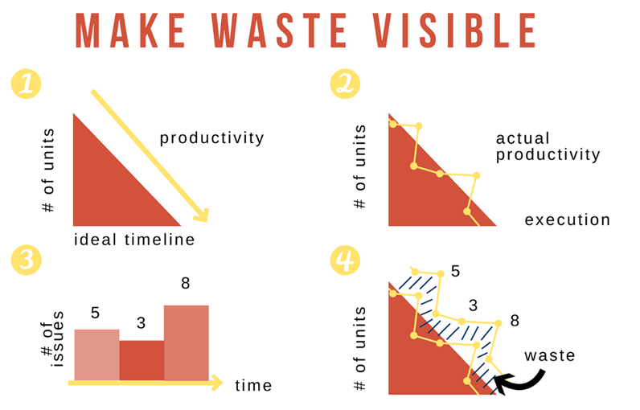
Make Technical Debt Visible
Here are the steps:
Plan the ideal
Track your actual
Track what you spend on waste
Put it all together
Help stakeholders visualize data (like progress, effect of debt, refactoring)
https://www.scrum.org/resources/blog/making-tech-debt-visible
Notes:
Here are steps:
Plan the ideal.
Track your Actual.
Track what you spend on waste.
Put it all together

Slide 21
Reasons to go into Debt
Prototyping
If code will be discarded, or rewritten, don’t waste time perfecting it
Getting a product out the door
Time is often crucial in a competitive environment
Fixing a critical failure
People are waiting
Maybe a simple algorithm is good enough
“Premature optimization is the root of all evil” — Tony Hoare, Donald Knuth

Slide 22
Architectural debt is costliest
Total cost of ownership generally higher than implementation-level issues; harder to get out of choices of:
Language
Middleware frameworks
Deployment pipeline
Consider:
What are the quality attributes that our software needs to ultimately satisfy?
How do these architectural decisions reflect those attributes?
Notes:
Your choices of technology, frameworks, integration, and deployment pipeline will all encapsulate architectural decisions and enable or hinder quality attribute requirements.
Best fix: explicitly allocate time to build and refine the architecture- have an explicit, iterative approach. Allocate that time based on quality attribute requirements. Consider the ways in which the architecture can be adapted to foreseeable changes.
It’s really a requirements problem: what are short-term and long-term goals of the business, and hence, key quality requirements. Are you starting a company that you are hoping will be quickly bought out, and you can cash out? Or does it need to scale up in some way?
(Remember: software engineering is the integral of programming over people and *time*).

Slide 23
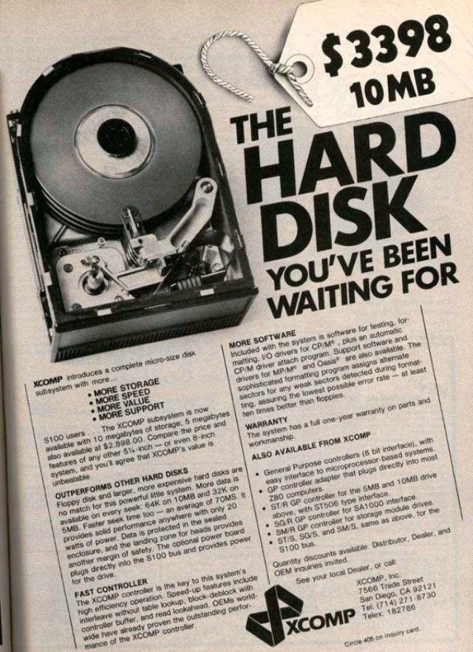
Y2K bug as example of architectural debt
How many digits does it take to store a year?
“I just never imagined anyone would be using these systems 10 years later, let alone 20.”
$24,847 in 2023 USD
Kruchten, Nord, Ozkaya:
“Managing Technical Debt: Reducing Friction in Software Development”
Notes:
Y2K bug is good example for architectural tech-debt. Storage and RAM SOOOO expensive, can’t we just put off fixing this problem for if it becomes needed?
The key idea is to NOT forget about this problem, but to consider planning around it
Discuss: if you had foreseen this problem, how could you have planned around it?

Slide 24
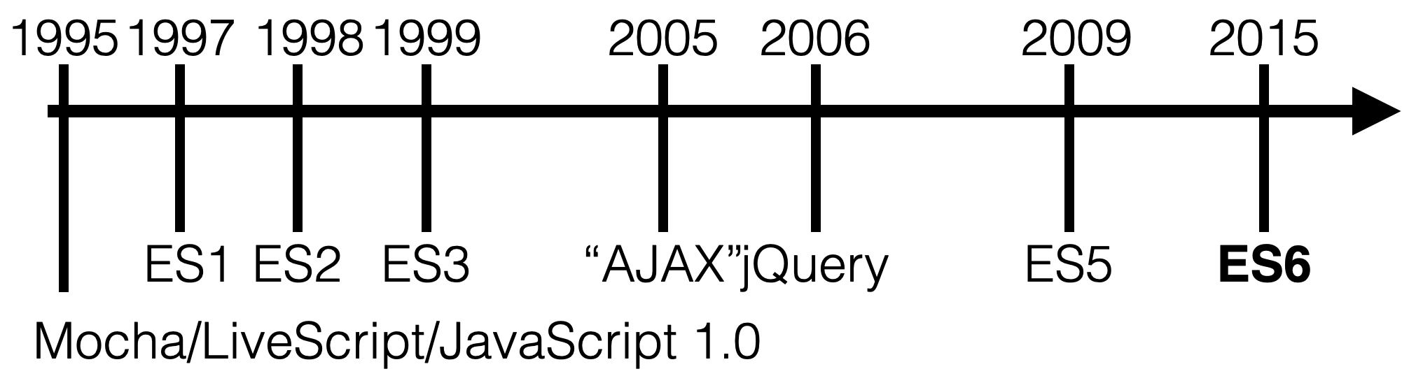
Evolving languages make debt
Choice of language can cause technical debt, particularly if that language is rapidly evolving.
Consider JavaScript
Classes
Promises
PLUS:
2016: ES7 (Array.includes)
2017: ES8 (Async/Await)
2018: ES9 (rest/spread operator, async iterators)
Notes:
JS has had a storied past.
ECMA: European Computer Manufacturers Association; technically “ECMAScript” not “javascript” but that’s another lecture
ES5: Minimal update with very little new features
ES6: Added “classes”. Before that, there was no notion of a class in JS. Whoops. ES6 also added promises
(click build) Also technical debt on this slide: since 2015 we have seen 3 new releases of JavaScript, bringing “async await” and many other language features This also does not represent transitions to TypeScript.
Choosing JS incurs tech debt, because it is basically a given that in a few years the language will have changes, that you will need to learn about, and perhaps adopt to support

Slide 25

Facebook’s debt
https://www.fastcompany.com/3028778/why-facebook-invented-a-new-php-derived-language-called-hack
Notes:
Facebook was originally written in PHP. They didn’t want to change. So they wrote a new language that closed various gaps in PHP’s design
In 2004 @ Facebook, using a now-popular framework like Ruby on Rails or Django wasn’t an option. Rails’ first public release was a few months later, and Django wasn’t unveiled until the following year. A decade later, PHP’s been widely derided for having a sprawling library of inconsistently named and defined built-in functions, syntax and semantics just different enough from related languages to confuse multilingual programmers, and a history of design decisions that made it easy to write insecure code.

Slide 26

Facebook’s debt
Hack added new safety features…
…automatic type inference
…lets you specify types of variables
…issues an error if code is logically inconsistent
When a file changed, two versions are compared to deduce what must be rechecked at a very fine-grained level
“Hack enables us to dynamically convert our code one file at a time” - Facebook Technical Lead HipHop VM (HHVM)
Facebook’s Runtime Engine supports PHP and Hack. https://hhvm.com/
Notes:
Traditional PHP is dynamically typed unlike languages like Java or C where types have to defined at compile time (statically typed).
Hack lets programmers specify the types of some variables in their code and uses logic to infer the rest based on how variables are used together, issuing an error if the code’s logically inconsistent.
When a file has changed, the two versions are compared to deduce what must be rechecked at a very fine-grained level: at the method level, not at the file level.”
Individual methods that have changed are re-examined by the type checker, which makes sure they’re still consistent with what it already knows about the rest of the code.

Slide 27

Instagram’s debt
https://thenewstack.io/instagram-makes-smooth-move-python-3/
https://www.fastcompany.com/3028778/why-facebook-invented-a-new-php-derived-language-called-hack
Notes:
Instagram was originally written in Python 2. In 2017 Instagram found that they had to add servers at a much faster rate than they were adding users, because the choice of python 2 was not scalable. So, the “big fix” noted in this blog post is that they, at an enormous development cost, migrated to python 3. There is nothing publicly written about the current state of scaling at Instagram today (5 years later), but anecdotally, they are in the exact same position: needing to add servers faster than adding users, to a degree where it is physically impossible to add enough servers fast enough to support platform growth.

Slide 28
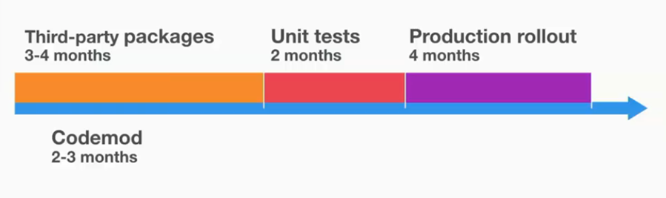
Instagram’s debt
From Python 2 to 3
Migrated in 10 months
Rule: not in Py3 => not used
Examples of refactorings:
Differences in unicode, str, bytes => add helper functions
Differences in iterators, such as map => convert all maps to Py3 list
Differences in dictionary order differences in the dumped JSON data => force sorted_keys in json.dump function
PyCon 2017 Keynote Talk: https://www.youtube.com/watch?v=66XoCk79kjM
http://euccas.github.io/blog/20170616/how-instagram-moved-to-python-3.html
Notes:
Reasons for migration: -Typing support for dev velocity, -Better performance than Python 2, -Community continues to make Python 3 better and faster Took 10 months. All changes were directly merged to Main branch. Initially infrastructure was extended to support both Python2 and Python3. In the talk, Lisa shared the challenges they faced in the migration process and how did they solved those problems.
Differences in unicode, str, bytes. Solved by using helper functions.
Pickle memcache data format incompatibility in Python 2 and Python 3. Solved by isolating memcaches for Python 2 and Python 3.
Iterator differences, such as map. Solved by converting all maps to list in Python 3.
Dictionary order is different in different Python versions, which caused differences in the dumped JSON data. Solved by forcing sorted_keys in json.dump function.
With Python 3, while CPU instructions per request decreased by 12%, max requests per second (capacity) had 0% increase! Found the root cause in the code of checking memory configuration, and the issue was memory optimization condition was never met in Python 3 as True because of unicode issue. Solved by adding a magical character “b”, just like this:
In Feb 2017, Instagram’s stack completely dropped Python 2 and moved to Python 3 (v3.6).

Slide 29
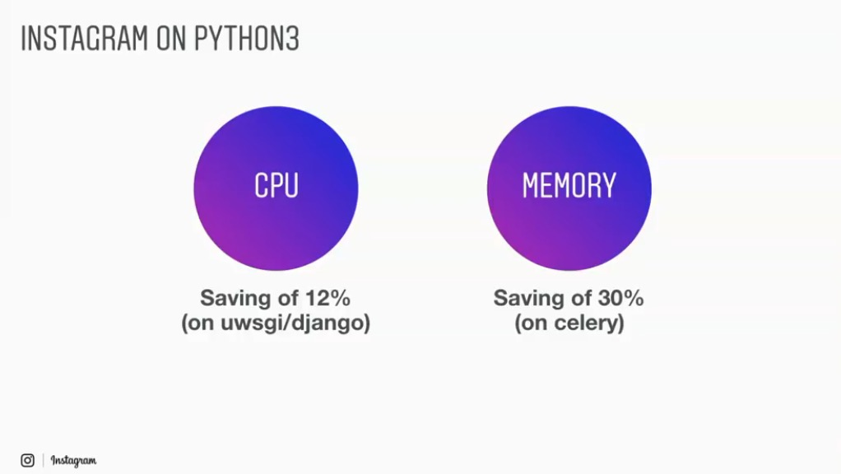
Instagram’s debt
Dropped Python 2 in Feb 2017
Notes:
Instagram’s python 3 migration took 10 months and was completed in Feb 2017. It has resulted in a lot of saving in CPU usage (12%) and memory utilization (30%).

Slide 30

Retire Technical Debt at Leisure
Set aside time to pay off technical debt:
Google has (had?) “20%-time” for tasks such as this.
A new initiative can take on some technical debt:
Refactoring at the start of a project.
Don’t keep on putting off!
When a crisis hits, it’s too late
Hasty fixes to unmaintainable code multiplies problems
Eventually mounting technical debt can bury the team

Slide 31
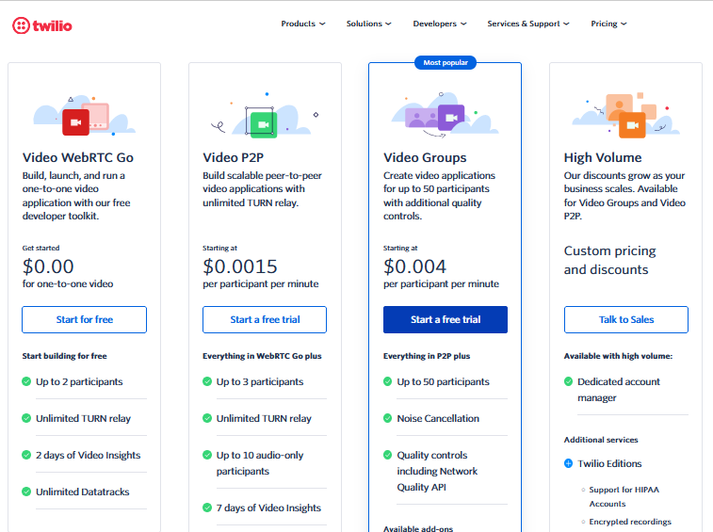
Now back to you…
Twilio Programmable Video v. Amazon Chime Video conferencing service
What if we need more than 50 people in a town?
Discuss strategies for determining if/when/how to migrate to Chime

Slide 32
Learning Goals
You should now be able to…
Define refactoring, technical debt, and give examples.
Explain how refactoring fits into agile process and help reduce technical debt
Suggest when it may be appropriate to accrue technical debt and when it may be appropriate to retire it
Notes:
Activity: Individually, Identify 5 candidates for Refactoring in your project code so far. Then come together as a group to share and discuss. Keep that list with you to work on during the project.

